Slide 1
Our Approach
AS - IS
TO - BE
Key Factors
Stringent timelines
ING internal hosting processes
People scale up
Business user acquaintance with new system
C
Portal
Re-host the portal
(.net)
Stepping Stone
A
Rewrite workflows in
PEGA
Workflow
(Microsoft Dynamics)
B
Or
Migrate to ING
Infrastructure
Infrastructure
(DXC)
D
Re-build the portal

Slide 2
Portal Application Re-hosting
Two possibilities from Infra perspective
TCS team activities
Partner with a TCS to support & maintain Applications .
Ensure scalability & extensibility to meet requirements of business operations.
Develop a seamless migration process and design to allow with optimal automation to enable future release across instances.
Classification of the provisioned DTAP environment like: If a Production environment was requested then it should have automated backup already activated etc.
Modify the CI List with the details of the newly provisioned environment.
Configuration of Web Server.
Configure with CDaaS pipeline Automation in Application Installation, Smoke Testing and Packaging and Deployment.
Ensure that specific compliance and security measures are adhered to/enforced upon the environment being provisioned.
Monitoring ,Reporting and backup services to monitor the operational efficiencies on a regular basis.
Responsible for Disaster recovery plan.
SOAP Services code and configuration changes for Pega integration in portal
Classification of the provisioned DTAP environment
ING Private Cloud
Prerequisite application software
ING Data
Center
Integration with CDaaS
Backup & Monitoring
Internal Security (MIS)
SOAP Service code and configuration changes
ING team activities
Source code /Binaries provided to ING by Vendor.
Infrastructure provided by ING (VM with operation System,IIS and .Net Framework).
Licensing Cost of software Provided by ING for (Operating System, Visual Studio)
Transition session and Documents to ING by vendor
CI List Update
Disaster Recovery Plan
Additional patching/hardening

Slide 3



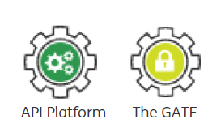



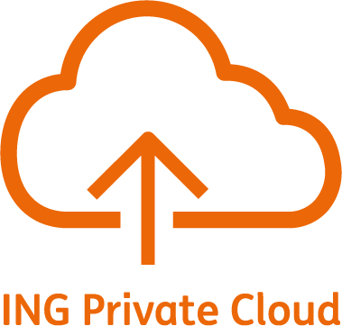

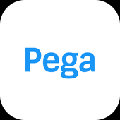
Re-build the portal
Our understanding : Technology
Hosting in IPC inline with TPA architecture
SEM-A monitoring.
Web Portal built on Polymer 2.
CDaaS & Fruityloops will be the delivery pipelines
Development will be fast and aligned with latest
technology stack
Hosting
Web Portal
Monitoring using ING tooling ELK, Grafana
& SRE Prometheus
Monitoring
User Experience
Web Components based Architecture.
Responsive Design
UX and theme inline with ING TPA
Test Automation using Selenium, cucmber.
API test automation using Karate
Automation
Interfaces
API interface inline with TPA web API
standards. API accessed via TPA Gate.
Microservice’s/API driven architecture

Slide 4
TCS Synergy for Portal re-build
Western Utrecht Bank (MijnWUB)
Touchpoint Platform
Inside Business Portal (IBP)
Guide
OnePAM
CCN
API Platform
GATE
Mortgage customer journey re-imagined. New digital portal created aligned to TPA and GTA. Hosted on Azure
Polymer components contribution & consumption
PoC performed using Kafka & consumption of CCN
Consumption for API publication for PSD2, OnePAM
Consumption for API publication for PSD2, OnePAM
Multiple squads part of the core team
Building functionalities for payments on IBP framework
REF Portal
Product developement leveraging TPA and aligned to GTA
DevTop pattern contribution. Assist teams with IPC pattern consumption
Usage and on-boarding for delivery pipeline and ING technology standards
Involved in part creation, usage and on-boarding of teams
Model Bank
ING Private Cloud (IPC)
IT4IT
Delivery Pipeline
CDaaS & Fruityloops

